Slide 1
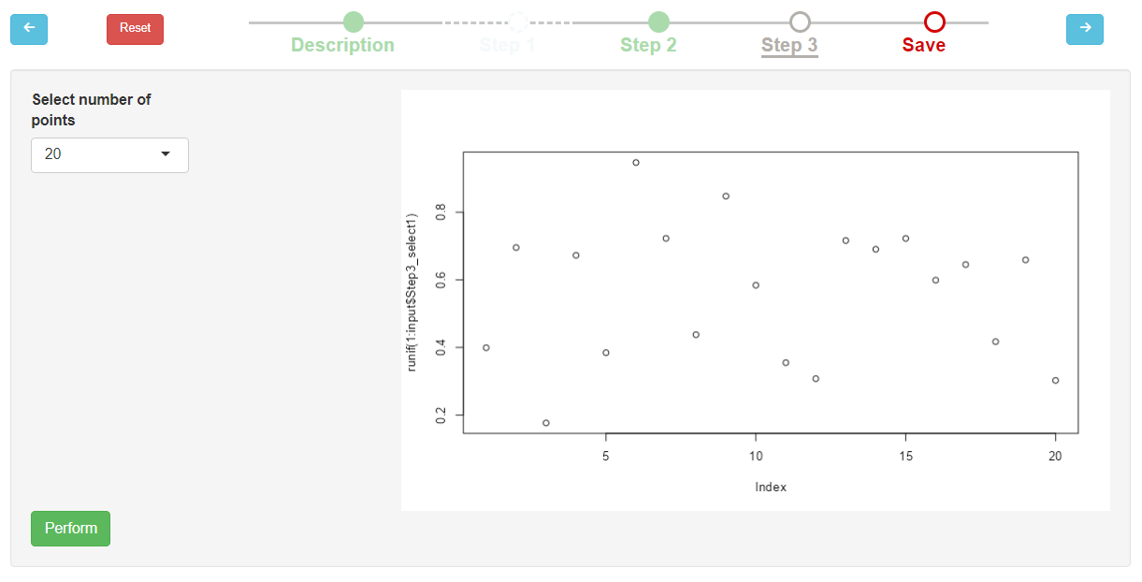
Navigation buttons (‘Previous’, ‘Reset’)
Process timeline
Navigation button (‘Next’)
Current step UI

Slide 2
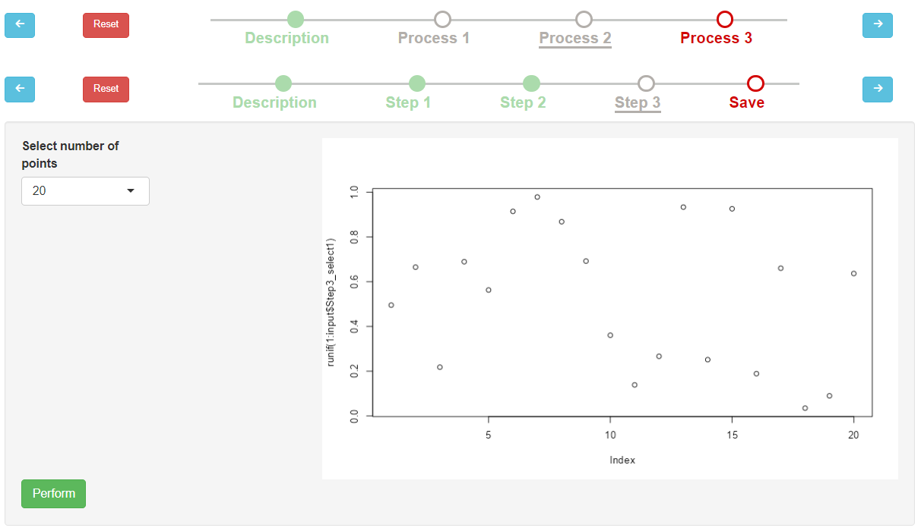
Pipeline timeline
Current process UI

Slide 3
Process
Input
Output
dataset
Step 0 (Description)
Step 1
Step 2
Step 3 (Save)
dataset

Slide 4
Pipeline
Process 1
Process 2
Input
Output
dataset
Description
Step 0 (Description)
Step 0 (Description)
Save
dataset
Step 1
Step 1
Step 2
Step 2
Step 3 (Save)
Step 3 (Save)
Step 3 (Save)

Slide 5

Step 1
Step 2
Step 3
Pipeline
Process 1
Process 2
Process 3
Step 1
Step 2
Step 3
Step 1
Step 2
Step 1
Step 2

Slide 6
Pipeline (complex workflow)
Process 1
Process 2
Process 3
Pipeline (complex workflow)
Step 1
Step 2
Step 3
Step 1
Step 2
Step 1

Slide 7


task 1
task n
task 1
task n
task 1
task n
task 1
task n
process 1
process n

